Slide 1
Final Project Presentation
Group Clover

Slide 2
Problem Statement

Slide 3





Problem Statement
Limited choose
Less room to contain
ECOSYSTEM
Waste time
Less advertise to appeal customers
No Evaluation
Limited waiters

Slide 4
Approach

Slide 5
Approach
Transfer 1
Order 1
Shop 1
Order
Status
Status 1
Transfer 2
Order
Order 2
Shop 2
Status
Center
Status 2
Transfer …
Shop …
Product
Order
Customer

Slide 6
Object Model

Slide 7
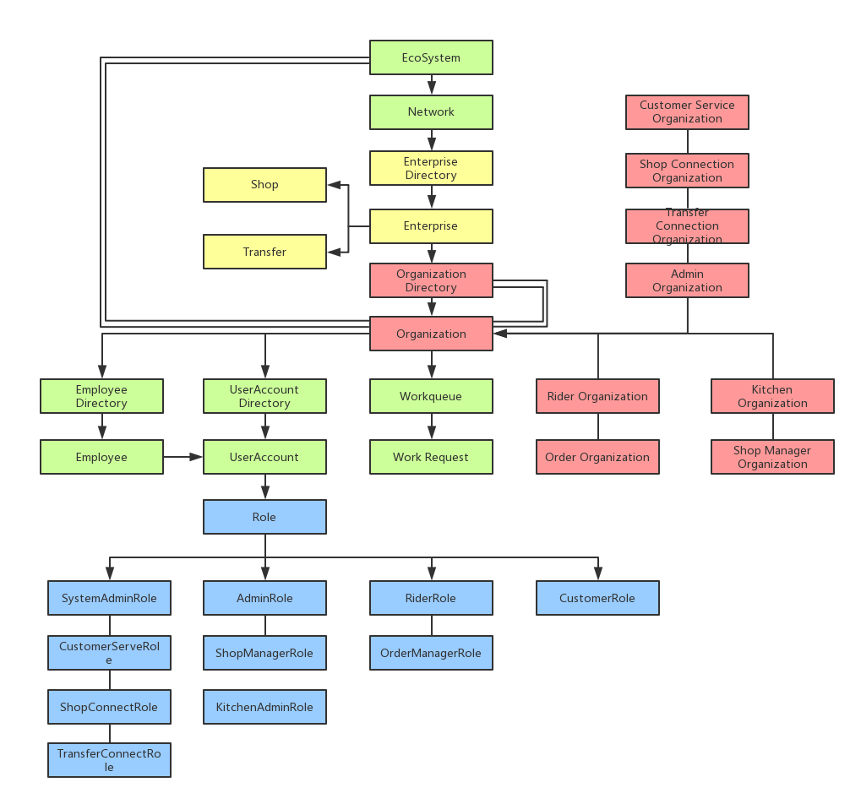
Project Model

Slide 8
Functionality

Slide 9
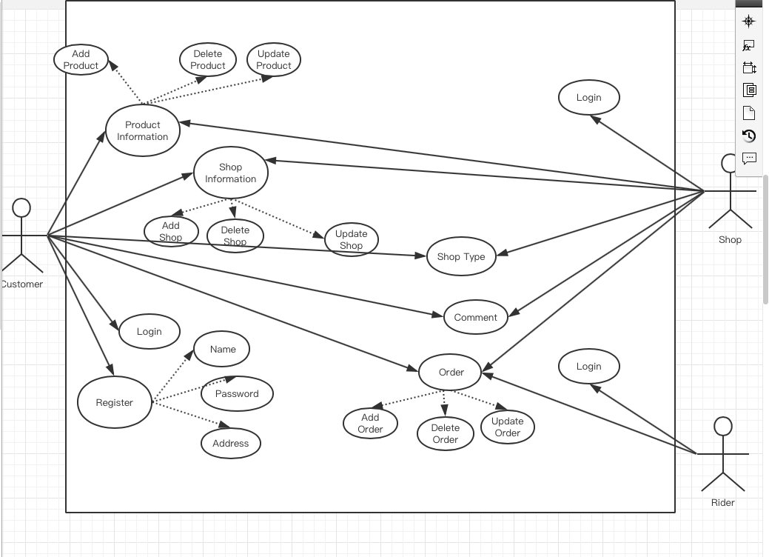

Slide 10
Screenshots

Slide 11
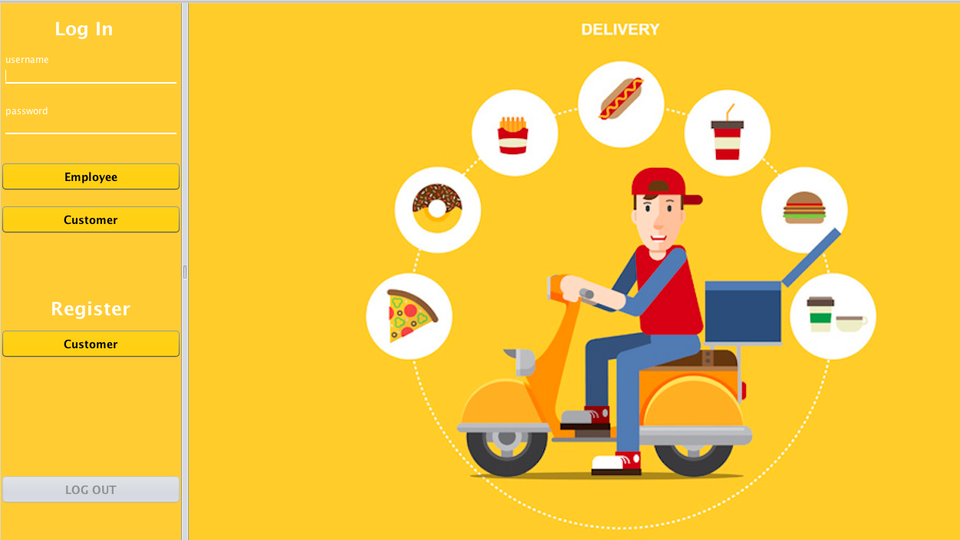
Home

Slide 12
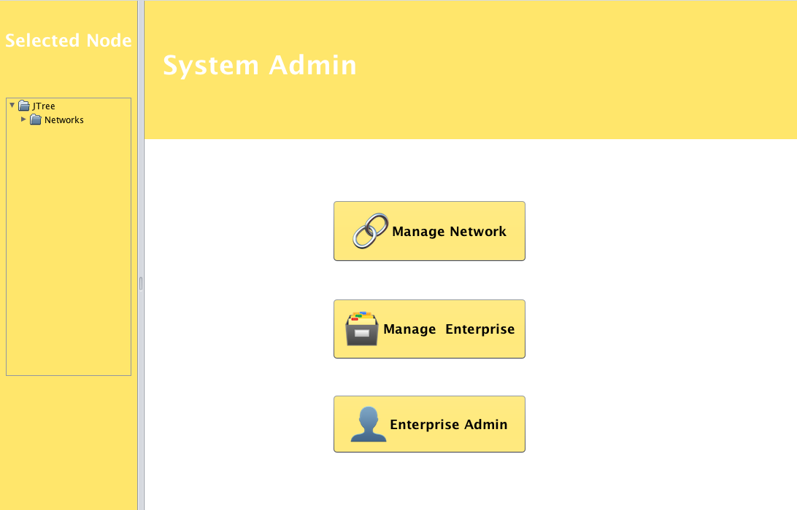
System Admin-Home

Slide 13
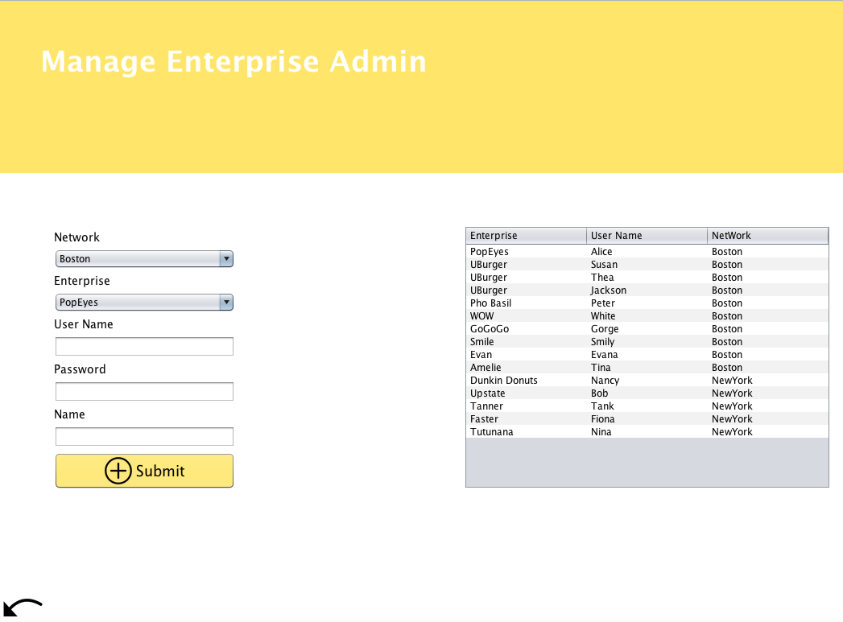
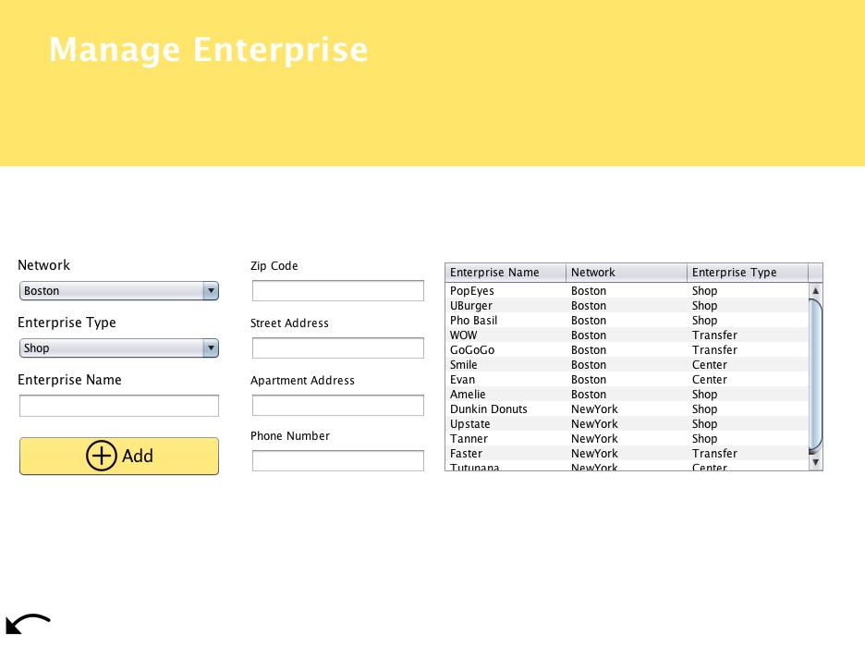
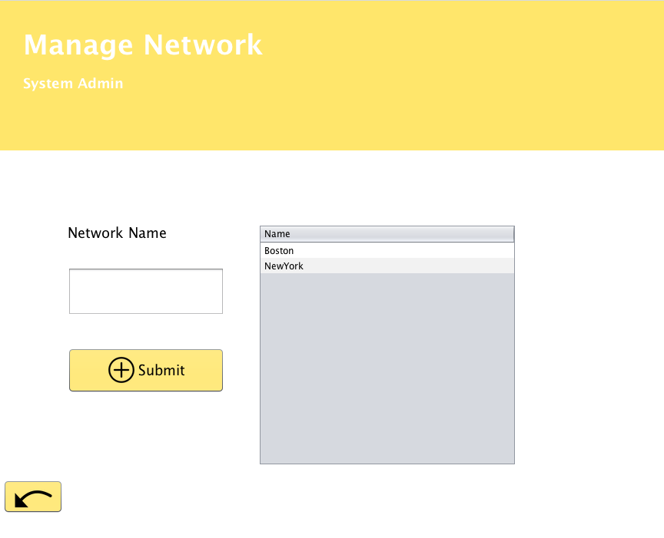
Create

Slide 14
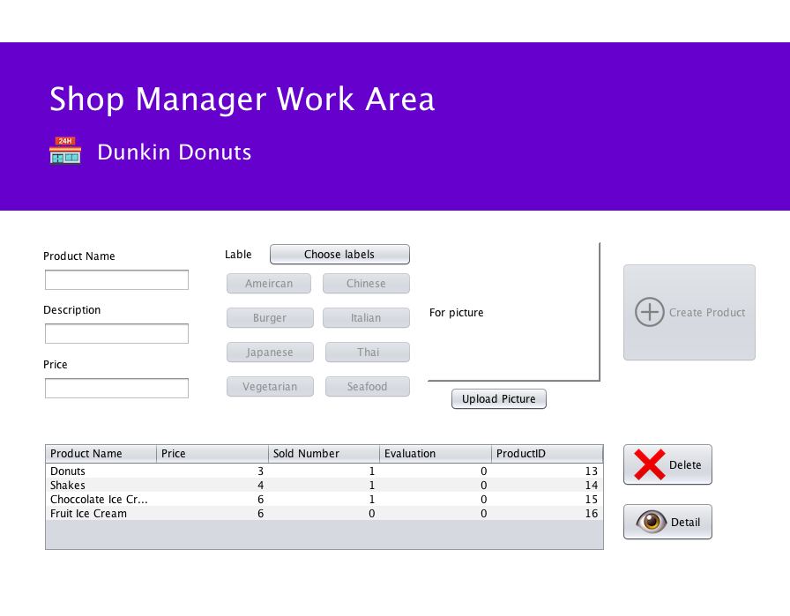

Slide 15
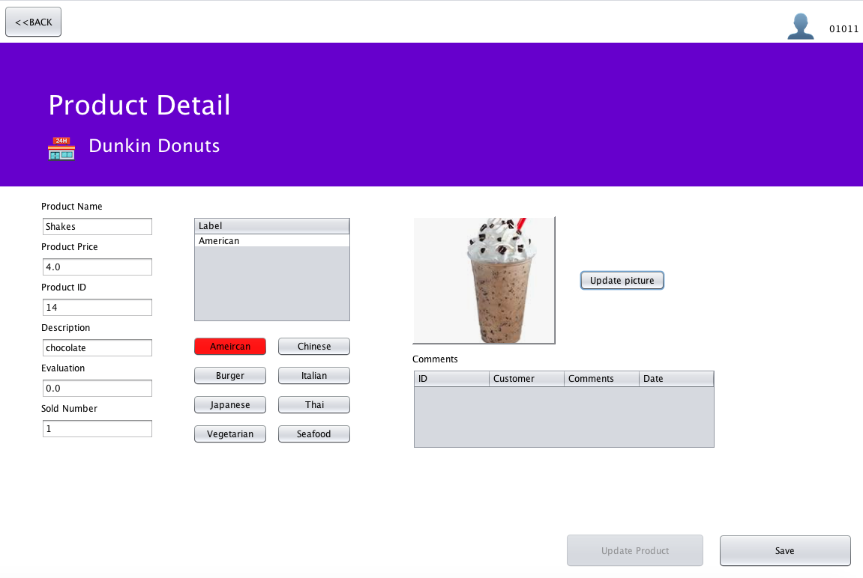

Slide 16
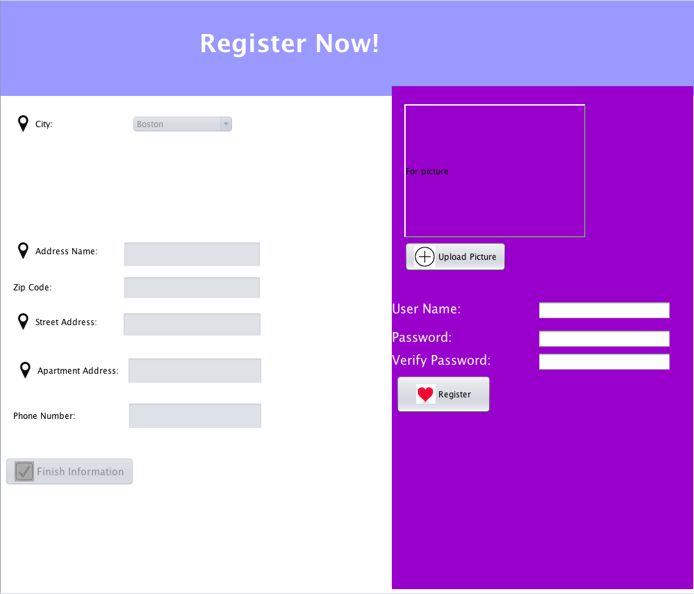

Slide 17
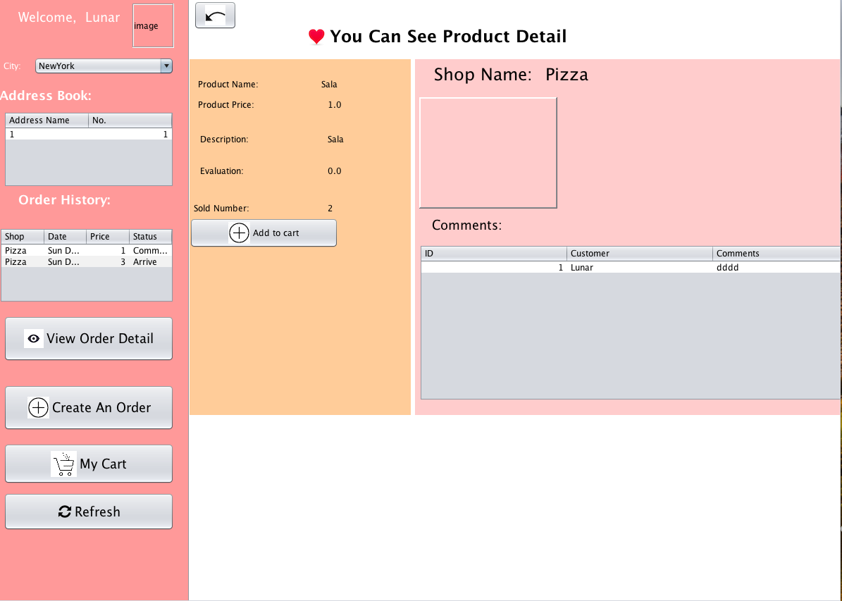

Slide 18
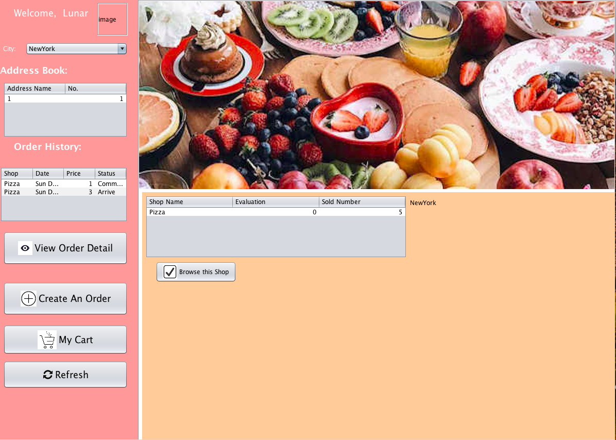

Slide 19
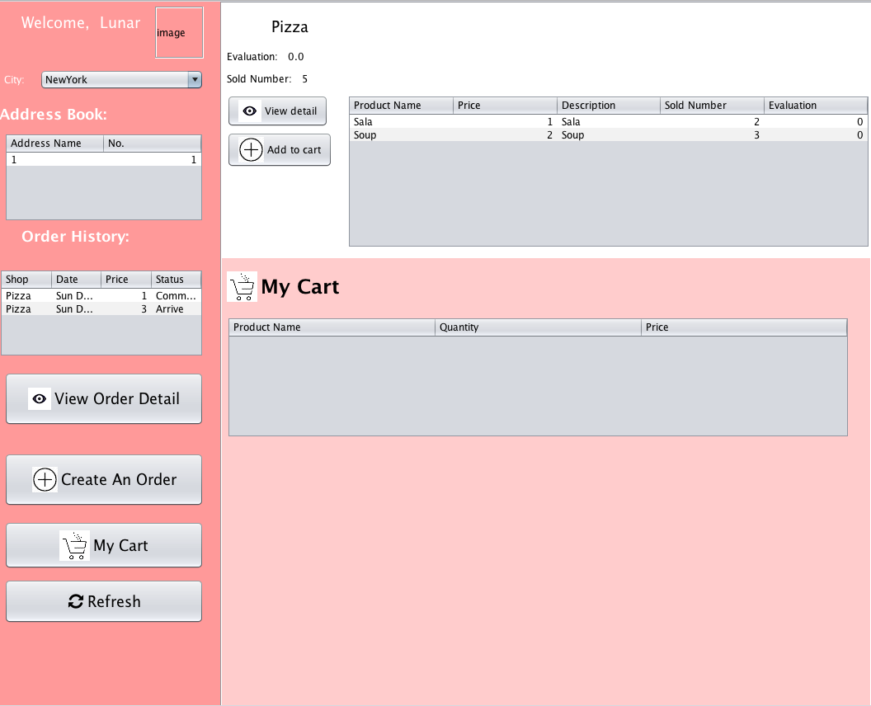

Slide 20
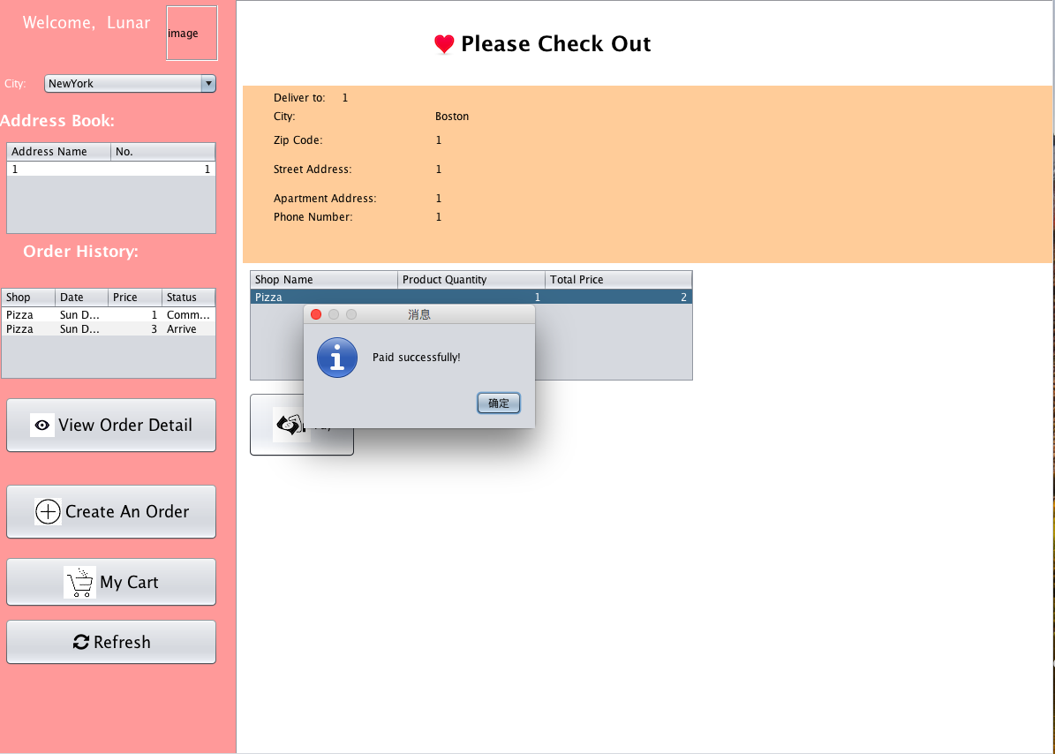

Slide 21
